Slide 1

Machine Learning Model for
Injector Emittance
Raffaele Campanile
University of Naples, “Federico II”
09/20/2018

Slide 2
OUTLINE OF THE PROJECT
Goal
Predict values of the injector emittance from a set of laser beamline input variables
How
Using a Machine Learning (ML) model
Why
We expect a really complicated relationship between the parameters and the emittance, ML models (like Neural Networks) are able to compute any function and moreover can learn what is this function by training on the dataset

Slide 3
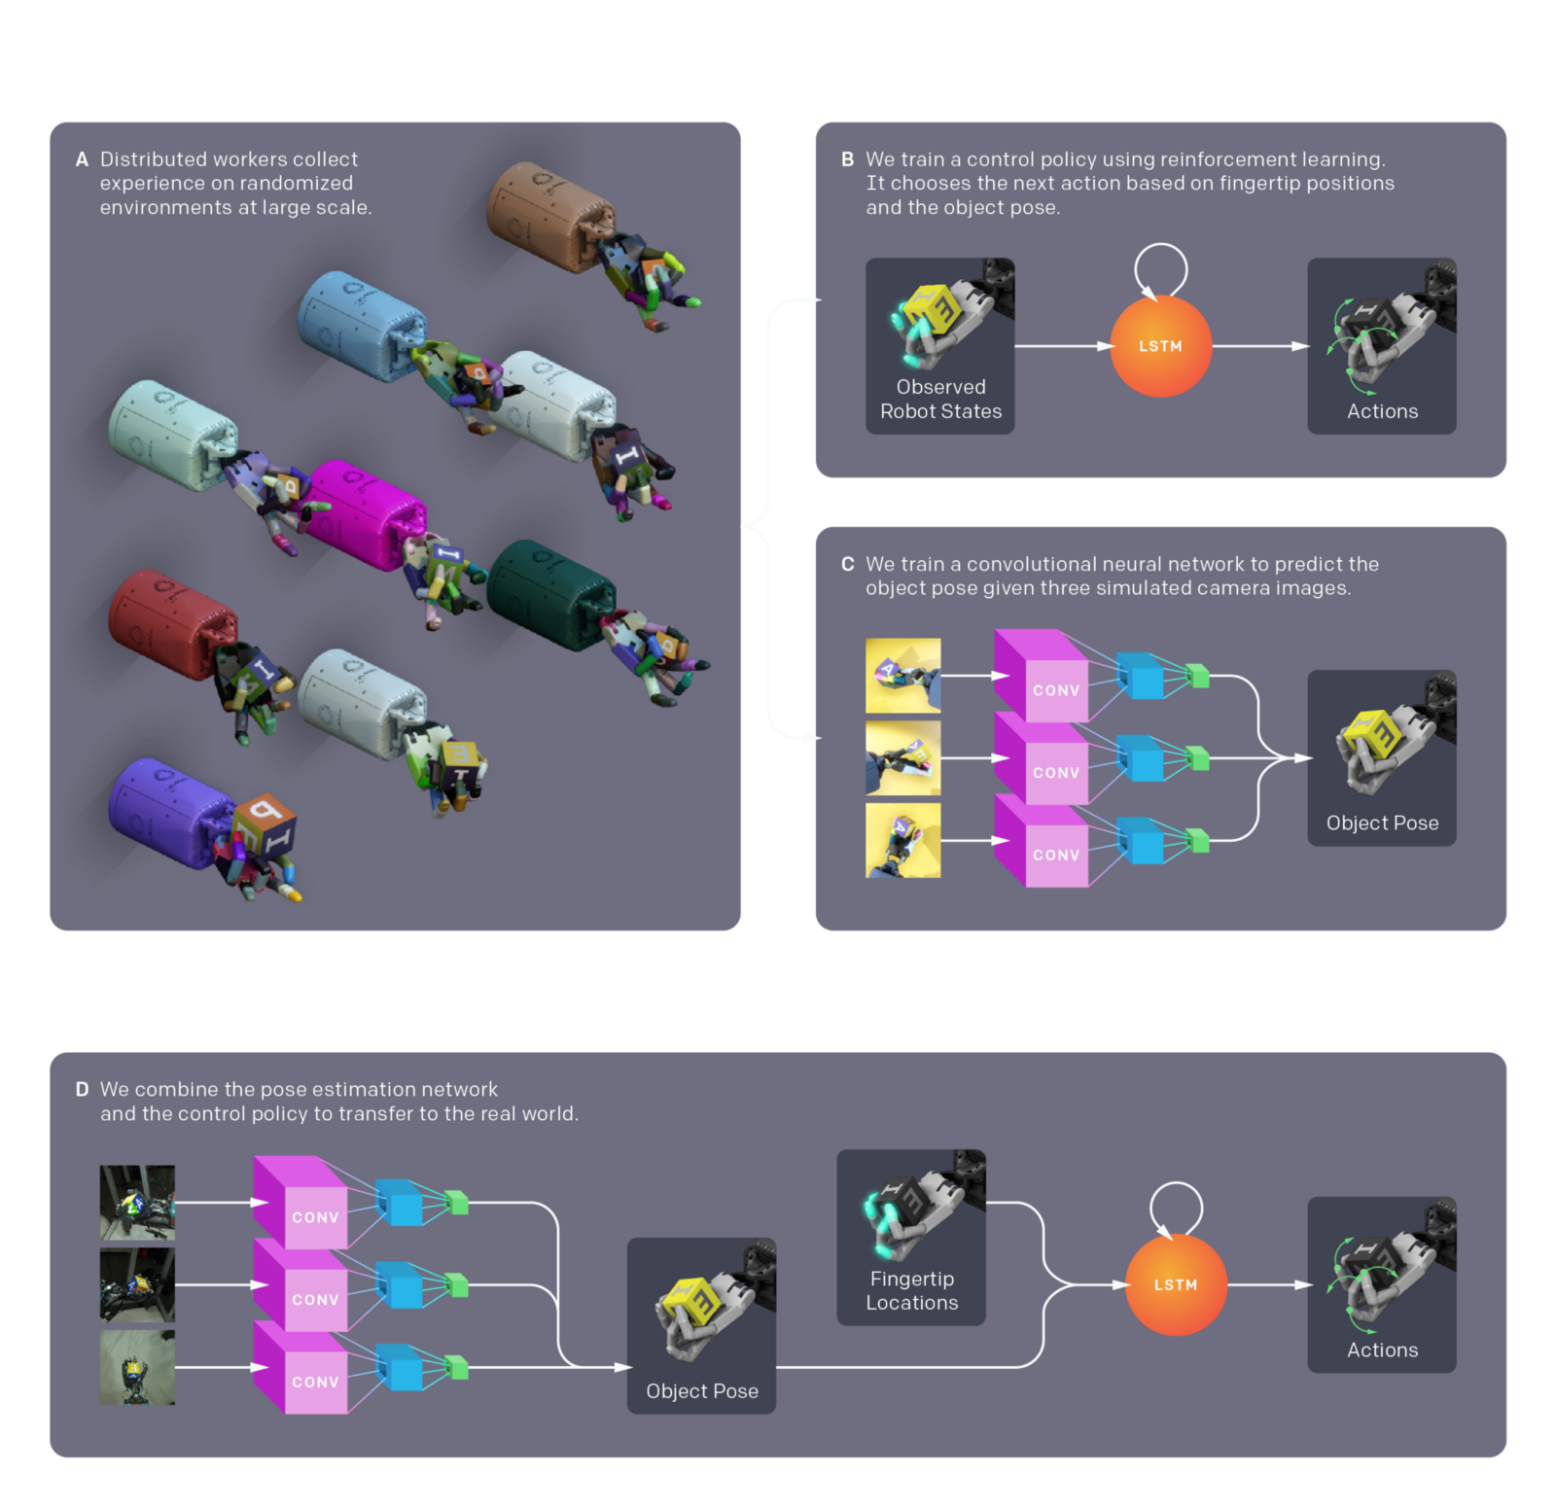
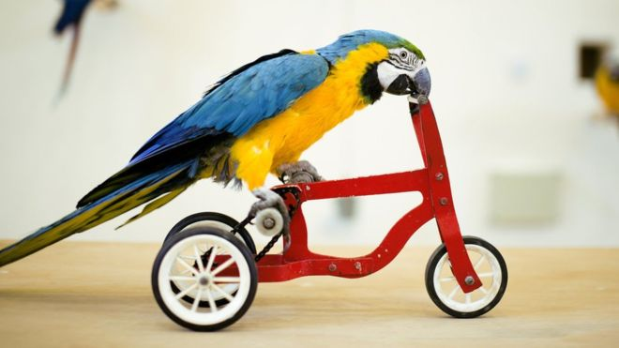

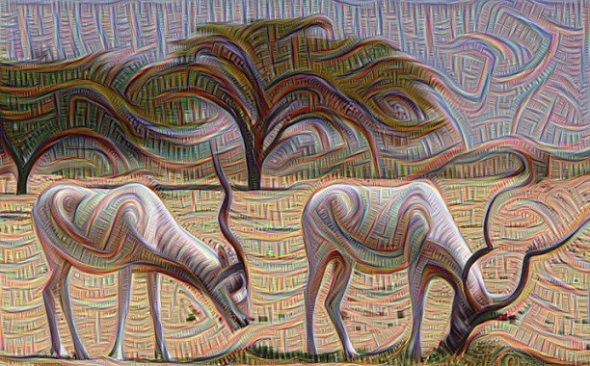
ACHIEVEMENTS OF MACHINE LEARNING MODELS

Slide 4
the WAY TO GO
1
Chosing the inputs
2
Building the dataset
3
Training the model

Slide 5

Step 1 : Selecting the inputs
As first step we selected, from all the parameters of the LCLS injector, two subset that we supposed to play the most important role basing on physical consideration.
The first subset was employed as ‘filter’ to exclude from our dataset non-standard configurations
The second one was part of the input of the Machine Learning model

Slide 6
DROP OFF VARIABLES
Process Variable | Device Name | Description
SHTR:LR20:100:UV_STS | Coherent 1 Laser shutter | Which Laser shutter is active, when both or none are it’s a strange config.
SHTR:LR20:90:UV_STS | Coherent 2 Laser shutter | Same as above
SHTR:LR20:117:SARM_STS | Stacker S arm shutter | At normal charge and for normal ops, both arms are open. If only one is open, typically means operating in low-charge mode or performing some MD activity.
SHTR:LR20:117:PARM_STS | Stacker P arm shutter | Same as above
BPMS:IN20:525:TMIT1H | BPM | Important to be sure that the beam is on at screen/wire
SIOC:SYS0:ML01:CALCOUT008 | Charge from gun | Values too far from 250 pC are not reliable
PS:IN20:1:SHUTTERSTATE | MPS shutter | No electron beam when closed

Slide 7
Process Variable | Device Name | Description
LASR:LR20:1:UV_LASER_MODE | Active Laser | Which of the Lasers is active
PSDL:LR20:117:TACT | Stacker Delay (Actual) | For normal charge and normal ops, always ~2 ps relative to the delay resulting in zero overlap
WPLT:LR20:117:PSWP_ANGLE.RBV | Stacker Waveplate | Changes the intensity balance between the two polarizations in the laser stacker
SIOC:SYS0:ML00:AO468 | UV laser pulse length (FWHM) | The most recently measured laser pulse length
OSC:LR20:20:POC | Coherent 1 phase offset | Should only be changed during a systematic phase scan
OSC:LR20:20:PDES | Coherent 1 phase desired | Generally this is -30 deg during normal operation
OSC:LR20:10:POC | Coherent 2 phase offset | Should only be changed during a systematic phase scan
OSC:LR20:10:PDES | Coherent 2 phase desired | Generally this is -30 deg during normal operation
ROOM:LR20:1:AIRTEMP1 | Laser room temperature | One of several laser room temp monitors
CATH:IN20:111:QE | Cathode quantum efficiency | Quantum efficiency
TORO:IN20:215:TMIT1H | Charge from gun | Absolute measure of charge emitted from gun
PMTR:LR20:121:PWR | Laser power on iris | Figure of merit when it comes to steering the laser before the iris.
LASR:IN20:196:PWR1H | Laser power on cathode
MIRR:LR20:125:M13_MOTR_H.RBV | IRIS steering mirror (horiz. and vert.)
SIOC:SYS0:ML00:AO328 (:AO329) | VCC X and y offset | The position on VCC if alignment has been performed, feedback o.
WPLT:IN20:181:VCC_ANGLE.RBV | VCC waveplate | Angle of the VCC waveplate
LASR:IN20:475:PWR1H | Heater_power
SIOC:SYS0:ML01:AO972 | Bunch_Length_XTCAV
CAMR:IN20:186:XRMS (and :YRMS) | Virtual cathode camera | RMS size from fit
CAMR:IN20:186:BACT | Gun solenoid | Actual magnetic field of Gun solenoid
SOLN:IN20:121:BACT | Gun corrector quad | Actual magnetic field of correctior quadrupole
QUAD:IN20:121:BACT | Gun skew quad | Actual magnetic field of skew quadrupole
QUAD:IN20:122:BACT | Quadrupole magnet | Actual magnetic field used for macthing the solution
QUAD:IN20:361:BACT | Quadrupole magnet | Actual magnetic field used for macthing the solution
QUAD:IN20:371:BACT | Quadrupole magnet | Actual magnetic field used for macthing the solution
QUAD:IN20:425:BACT | Quadrupole magnet | Actual magnetic field used for macthing the solution
QUAD:IN20:441:BACT | Quadrupole magnet | Actual magnetic field used for macthing the solution
QUAD:IN20:511:BACT | Quadrupole magnet | Actual magnetic field used for macthing the solution
QUAD:IN20:525:BACT | Quadrupole magnet | Actual magnetic field used for macthing the solution

Slide 8
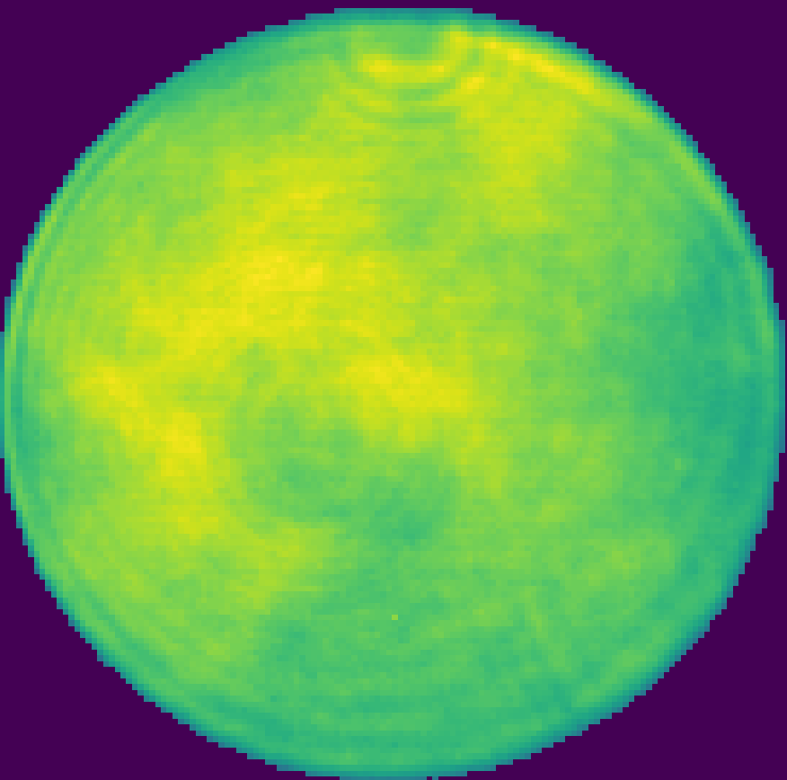
VCC images
At the beginning, the idea was to employ Virtual Cathode Cameras Images as part of the input of the ML model. Unfortunately, we couldn’t include them because of the low frequence with which they are saved (twice a day) and rarely together with emittance.
In our dataset is really important to have input variables and output variables measured at the same time.

Slide 9
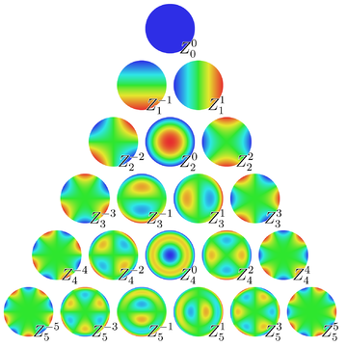

Zernike Polynomials
Very famous in beam optics, we are interested in them beacuse are used to approximate VCC images. The great advantage is that you can just need coefficients (~45 in this case) instead of the whole VCC image (640x480 pixels) so you can save it more frequently.
In order to empoly them we checked two aspects:
Agreement with VCC images
Autocorrelation time

Slide 10
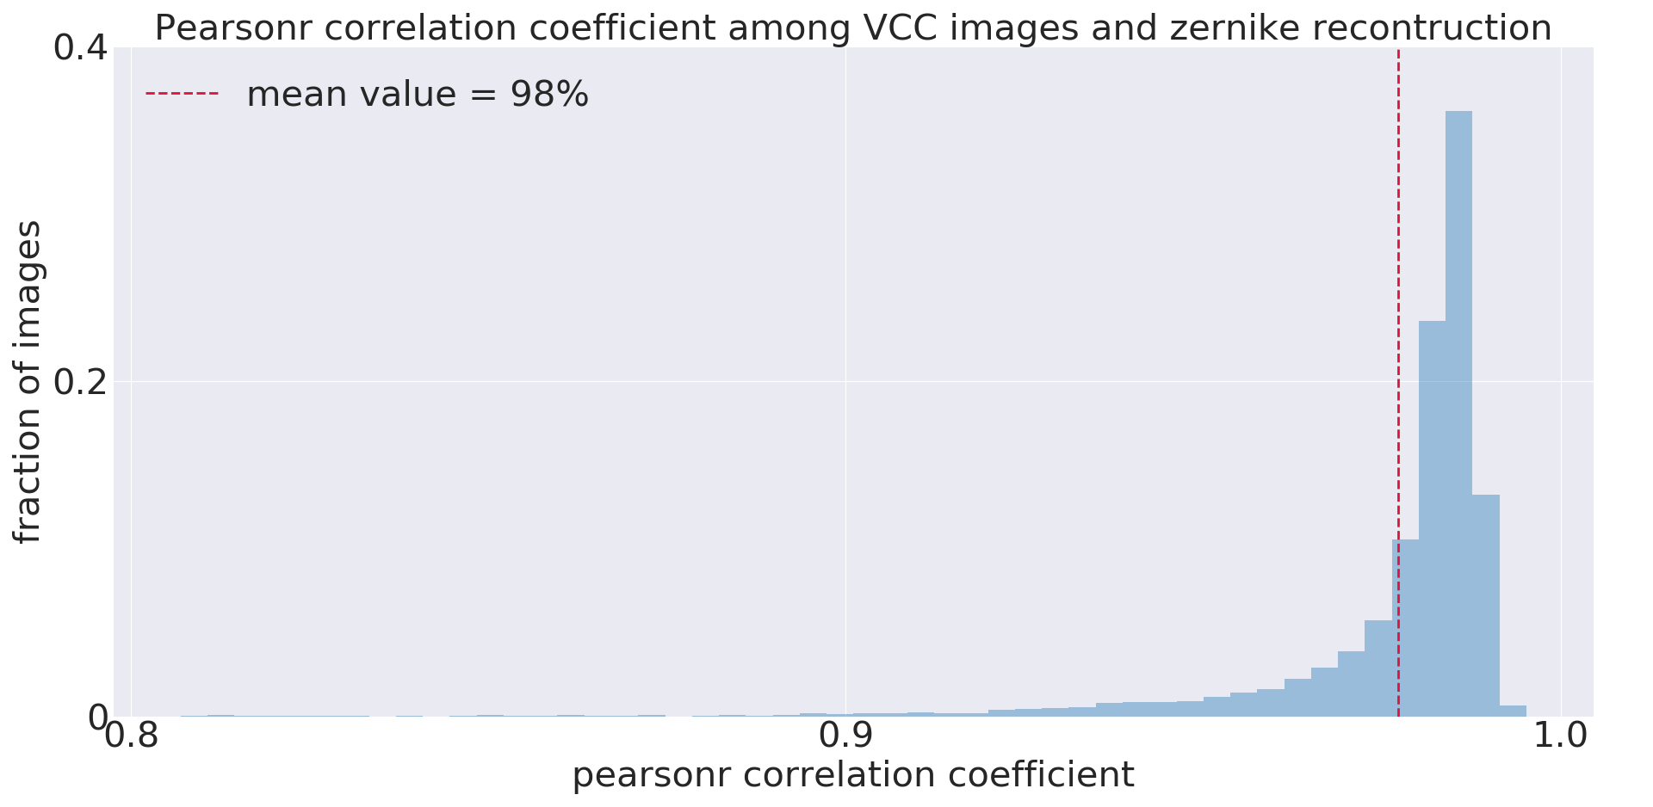
Agreement with VCC images

Slide 11
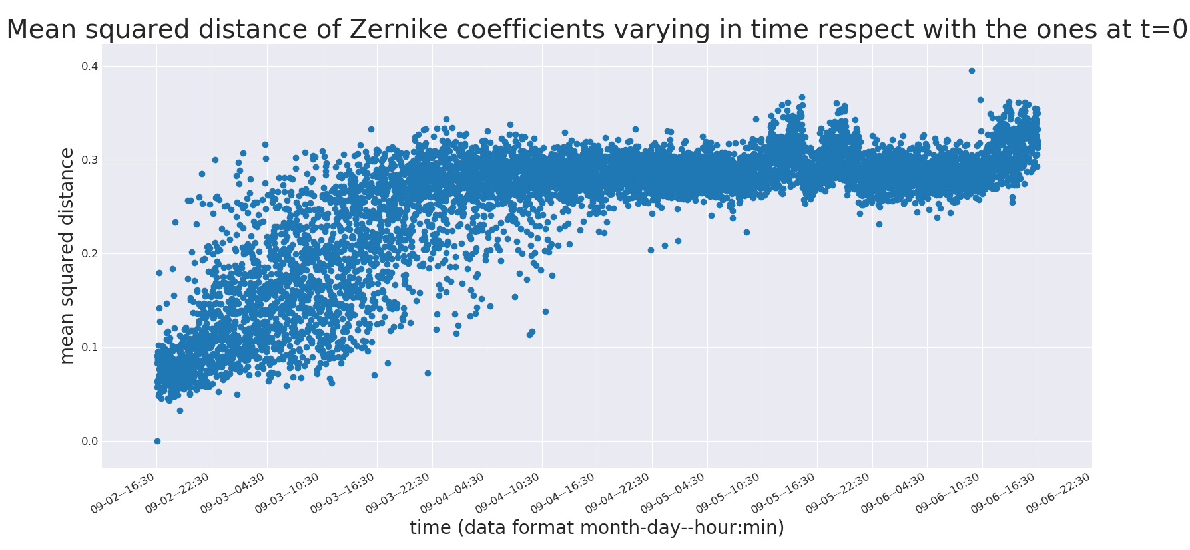
Autocorrelation time
~30 hours

Slide 12
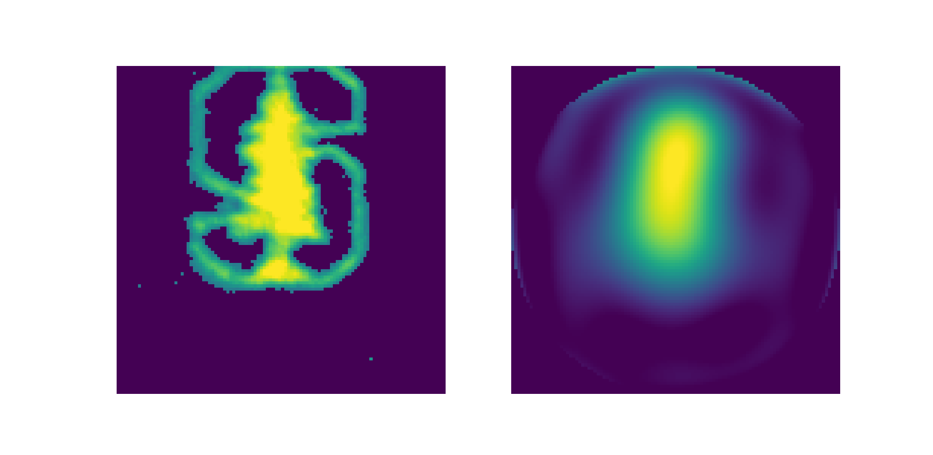
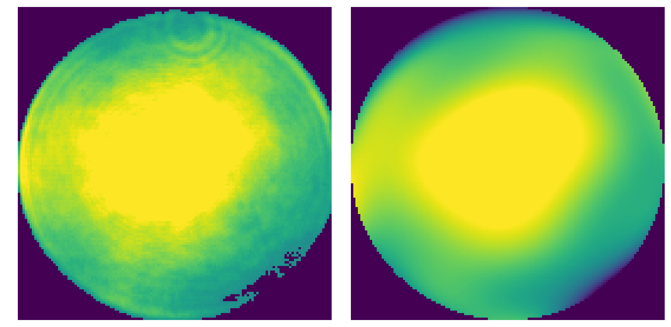
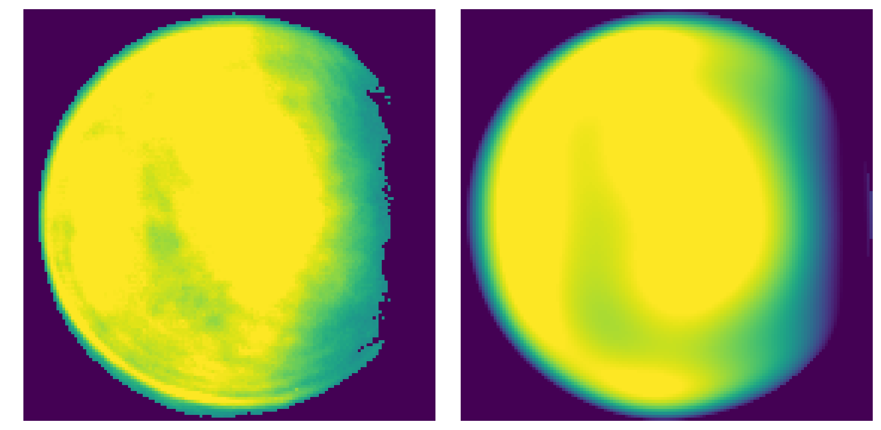
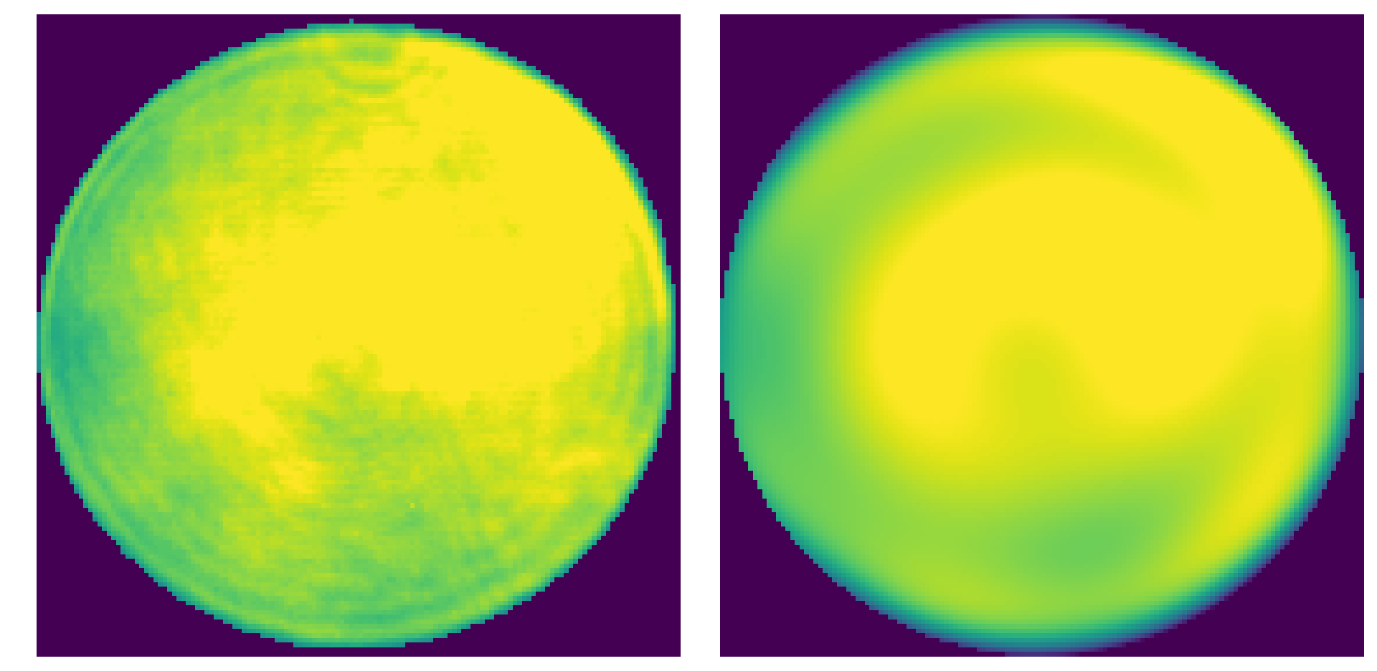
A couple of examples…
Too much…
VCC images
Zernike reconstrution

Slide 13

Step 2 : Turning the data into a dateset
The data available in the LCLS database are not ready to be analyzed an ‘input’.
The transformation of raw information into an ordered table or matrix is the most important and difficult task.
This part of the process is so important that it requires the most of time spent on the project, our case not being an exception.
1
Target the important periods
2
Gather input values measured at the same time
3
Drop off outliers from the dataset

Slide 14
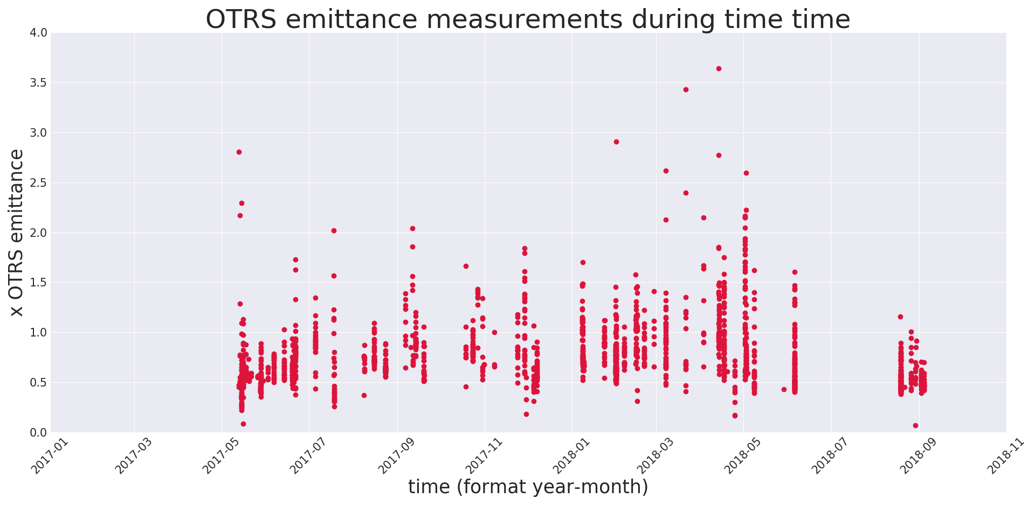
Targeting the period of interest
~ 2000 datapoints

Slide 15
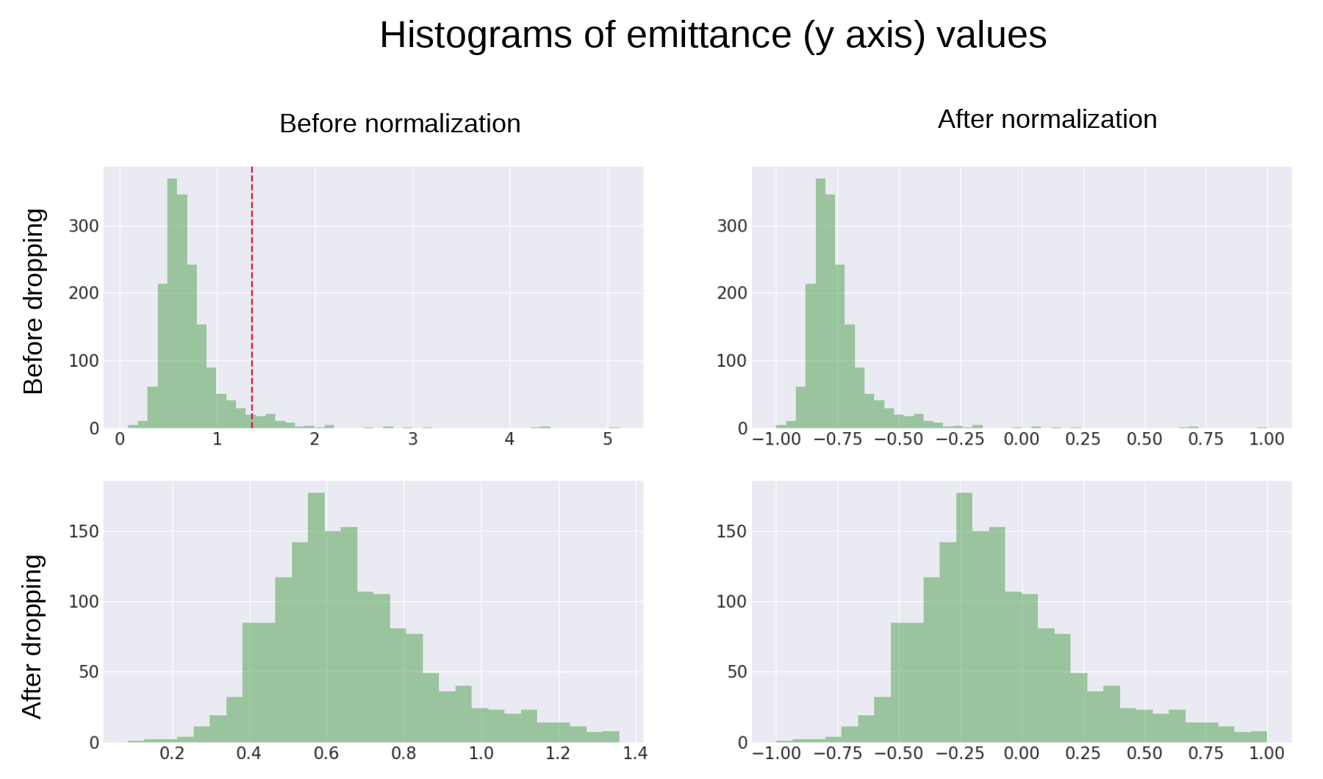
Dropping off outliers
~ 1000 datapoints

Slide 16
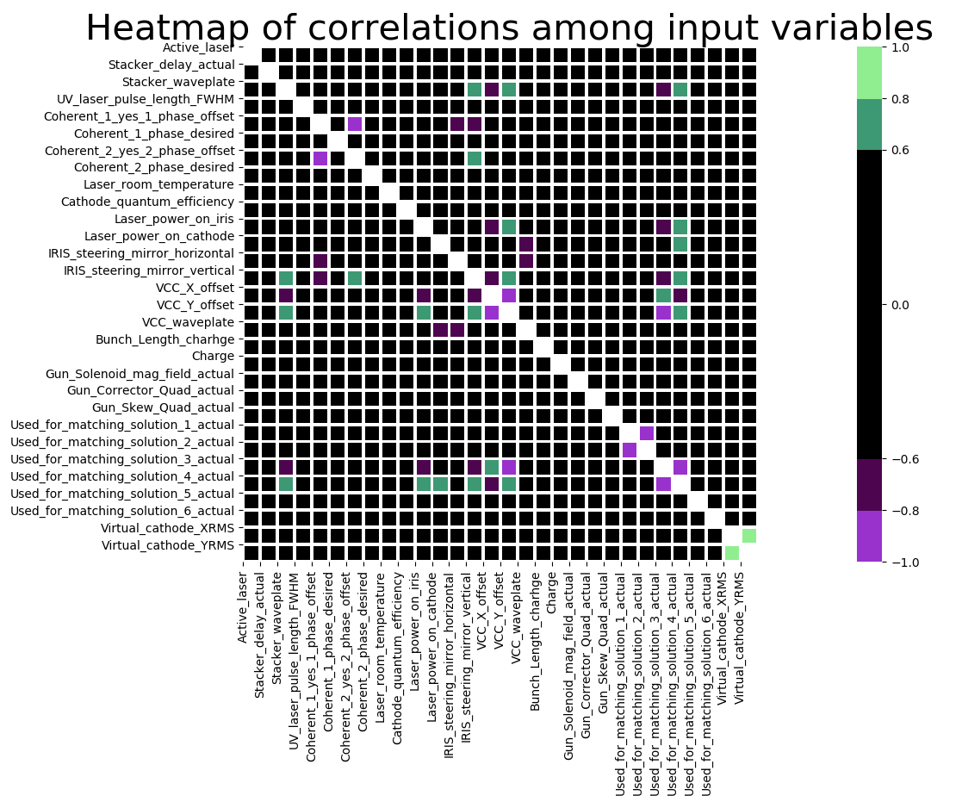

Analyzing the correlation among parameters
We calculated the pearson correlation coefficient among every input variable.
$$ρ=\frac{cov(x,y)}{σ_{x} σ_{y}}$$

Slide 17

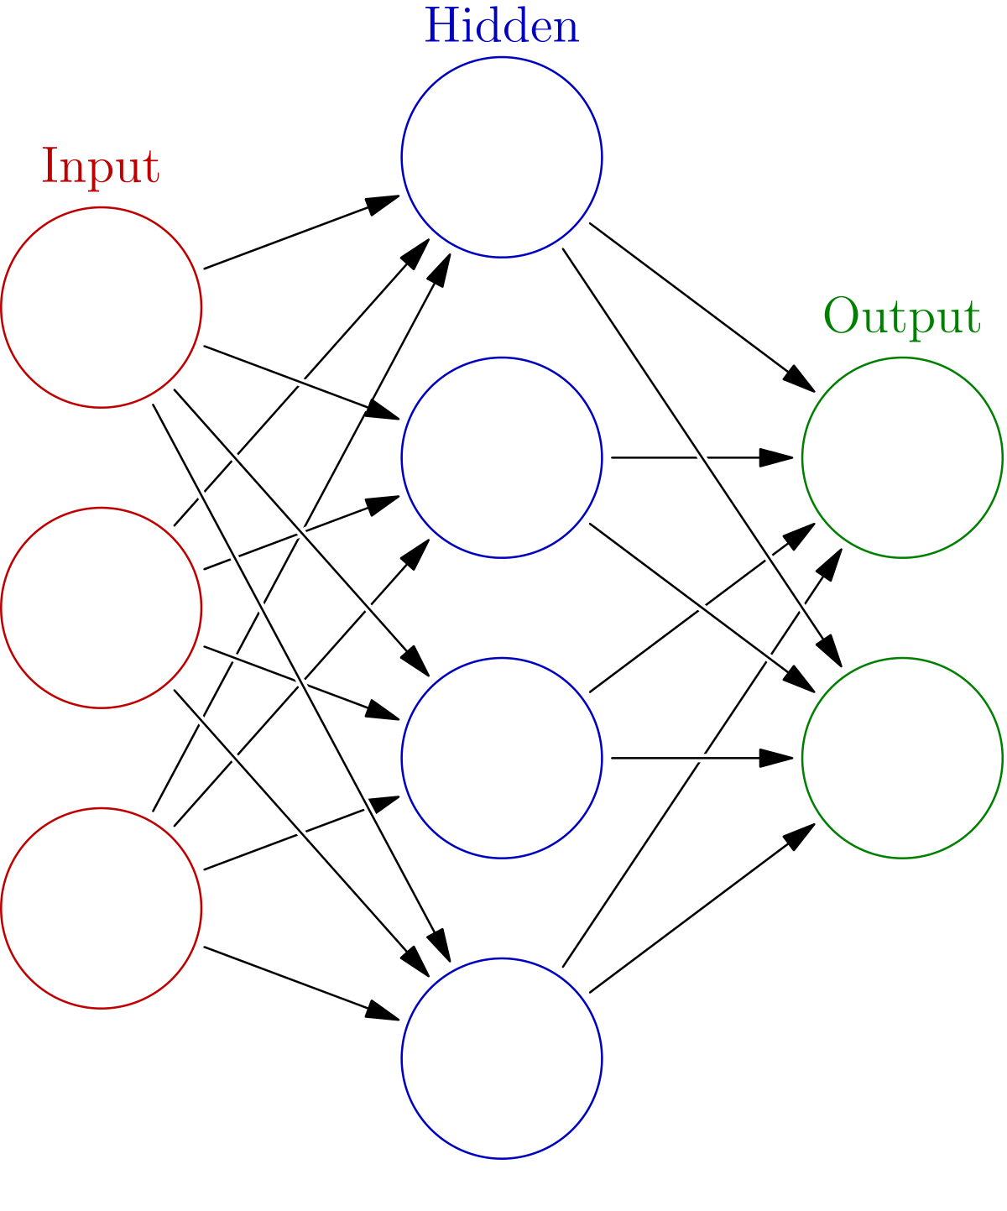
STEP 3: TRAINING THE MODEL

Slide 18
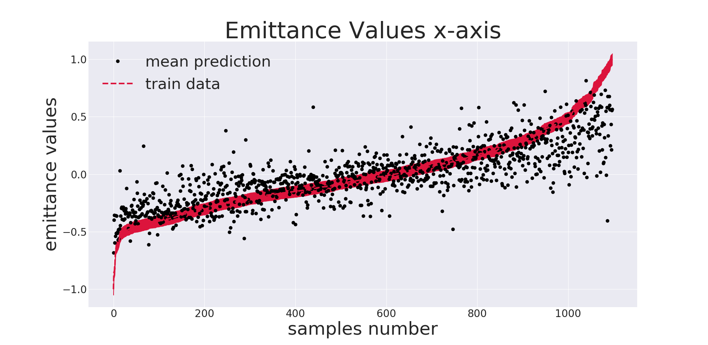
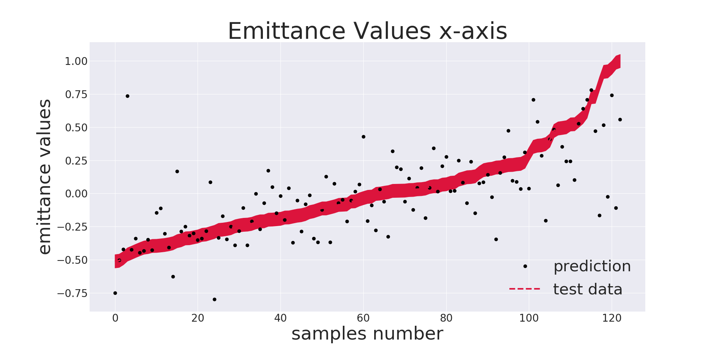
THE FIRST TRIAL
Train data
Test data
This graphs show that the NN is not performing well neither on the training set nor on the testing.
Not only is not generalizing, but is failing to fit the data on which it was trained too
Can we do better?

Slide 19
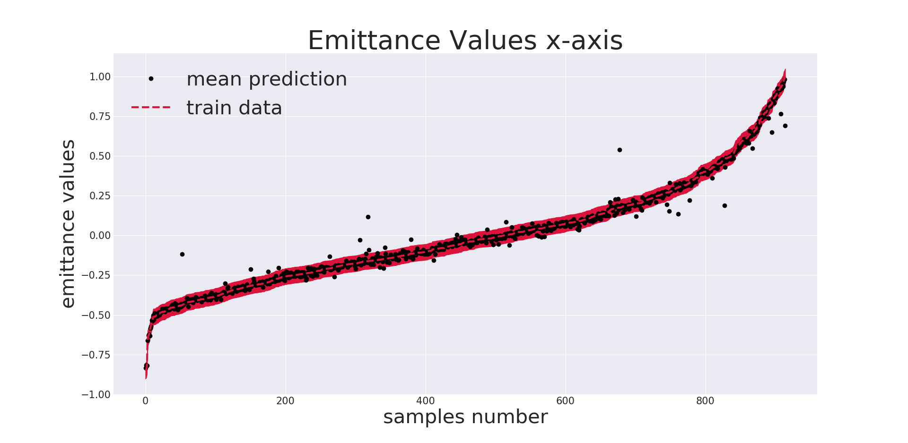
Results on Training set (overfitting)

Slide 20
IMPROVEMENTS
To improve the predictions on the test set, we double checked our PV list, excluding the ones that were probably causing noise and confusing the network.
In addition, to increase the size of the dataset, we included the measurements of the wire emittance. From a physical point of view they should be very similar quantities and this was confirmed by rough correlation analysis we performed.

Slide 21
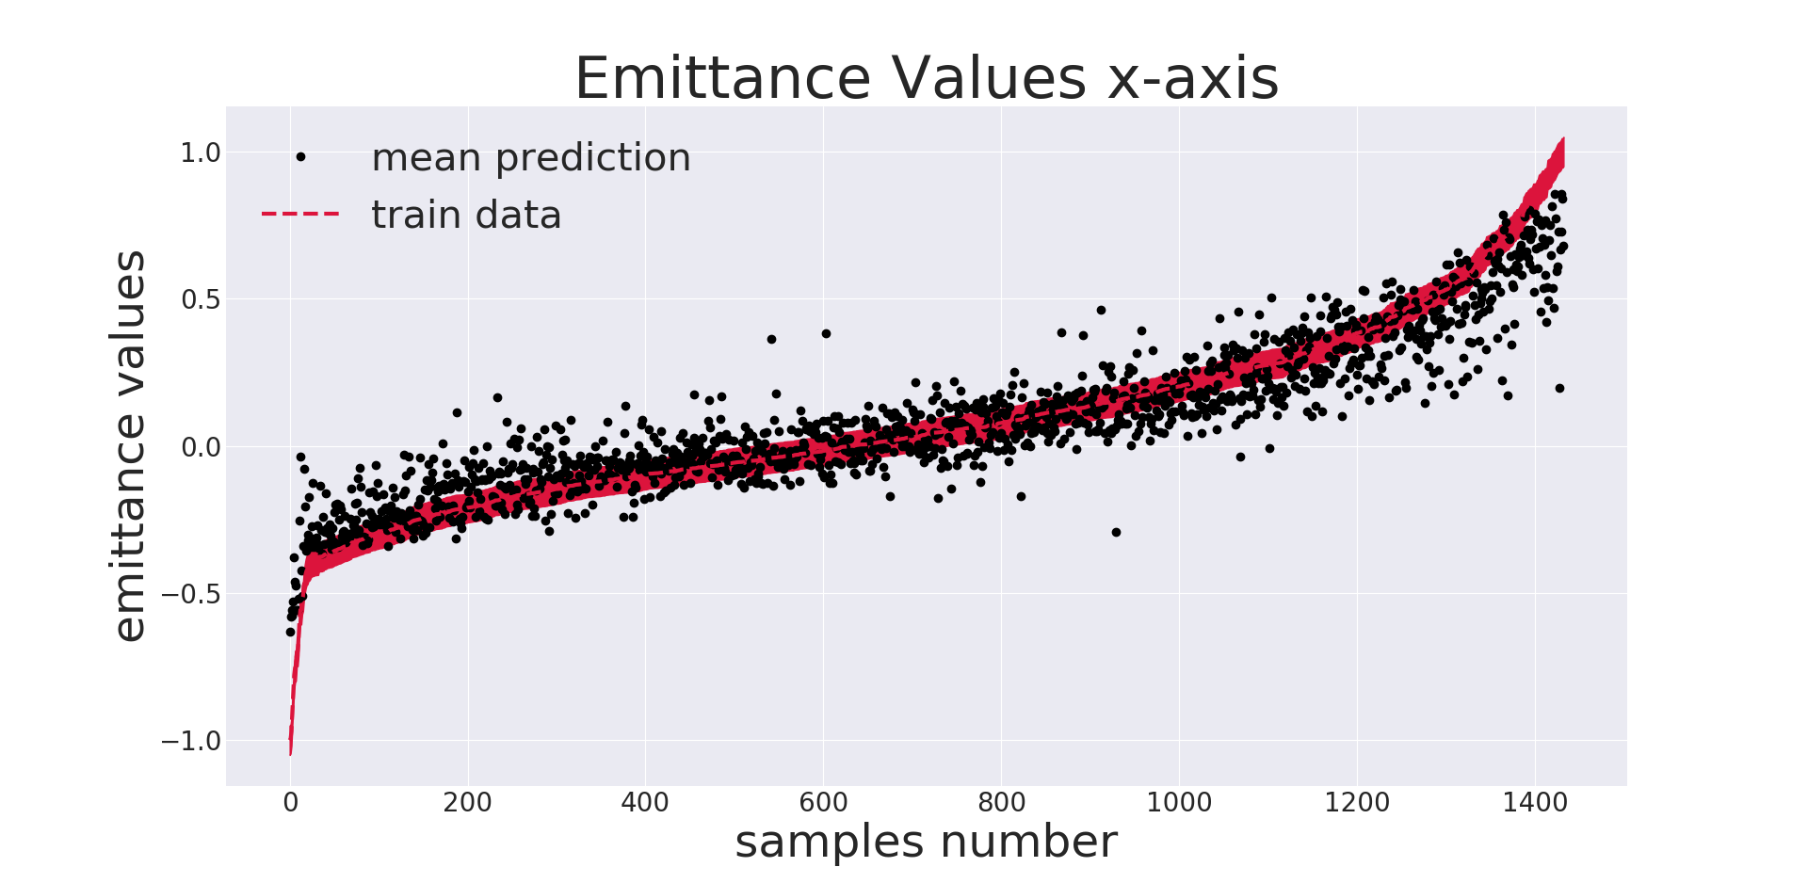
Results on Training set

Slide 22
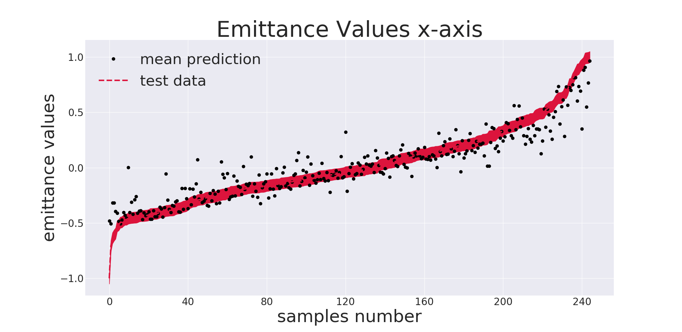
Results on Training set

Slide 23
CONCLUSIONS
We created a ML model able to predict the injector emittance very roughly. We demonstrated that even simple Neural Networks can fit the data doing very well on the training set, this meaning that a relationship among our input and our output exits.
The prediction is still noisy, just follows the trend roughly. The last result is surely the most encouraging one: it highlight that the data we have are not enough. Increasing the data of 50% (furthermore of a different kind) leads to significant improvements in the network performance. - try predicting just with wire emittance measurements
- continue to gather data during present run
This encourage us to try again this approach with a greater dataset

Slide 24
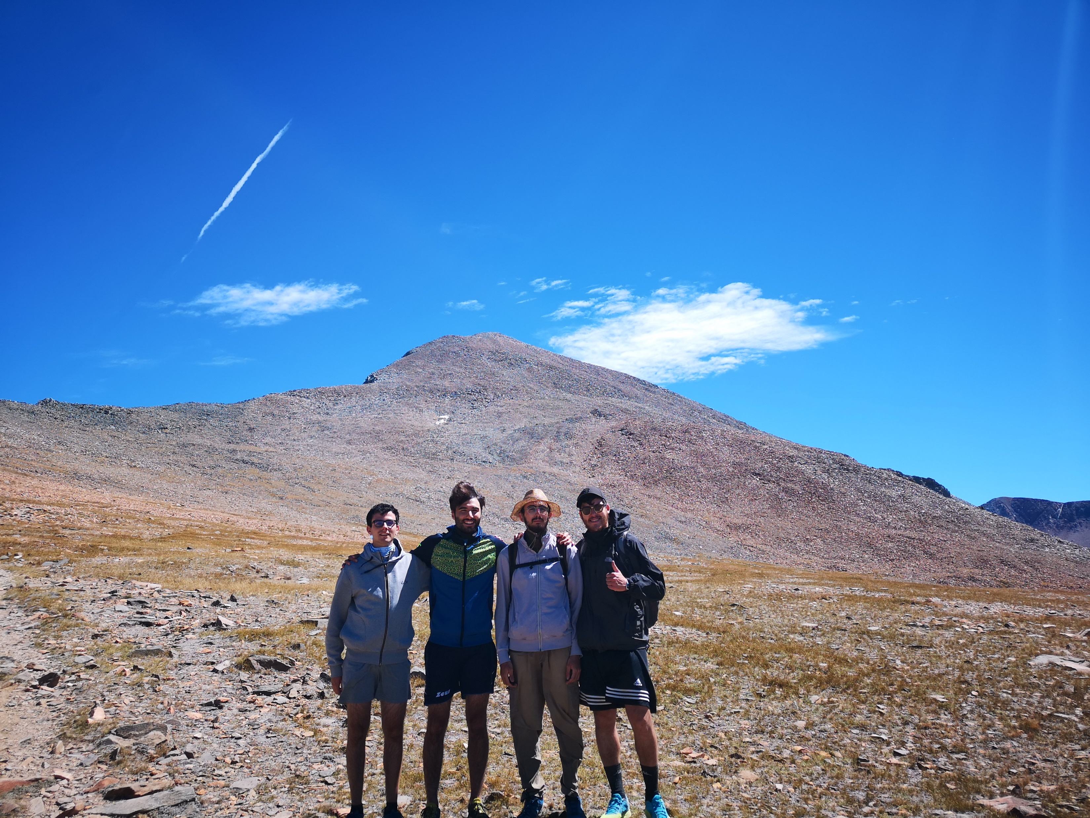
Thank you very much!

Slide 25


